Slide 1

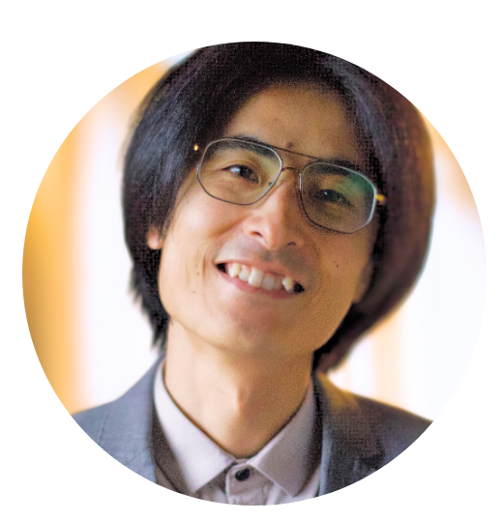



Writing a reproducible PhD thesis using GitHub, R, and Docker
MEET-UP
Eindhoven University of Technology
Nami Sunami
Data Steward | TU Eindhoven
n.sunami@tue.nl
DOI: 10.53962/x4b0-jtqj

Slide 2




Join Our Community
openscience@tue.nl
sites.google.com/view/osceindhoven
Notes:
If you would like to join a community of like-minded people at TU/e – you are welcome to become a member of the OS community Eindhoven.
It’s a space where you can exchange experiences with fellow researchers, learn something new and/or share your knowledge with others.
Starting from the new academic year, we are going to have budget from NWO which will help the community to develop and grow and you can be part of it.

Slide 3
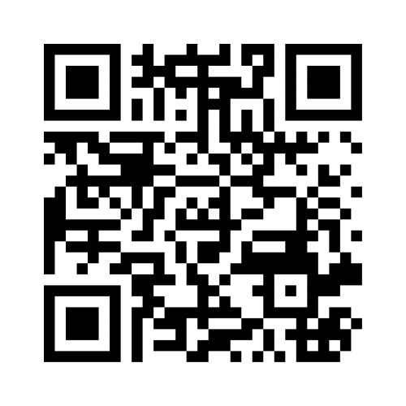
First: Lunch & Menti
menti.com/al94p5cm6iwg

Slide 4
Writing a reproducible PhD thesis using GitHub, R, and Docker

Slide 5
Disclaimer: I’m just sharing my journey (not giving advice as a data steward)

Slide 6
Why did I want to make my thesis reproducible?

Slide 7
A problem using Google Docs

Slide 8



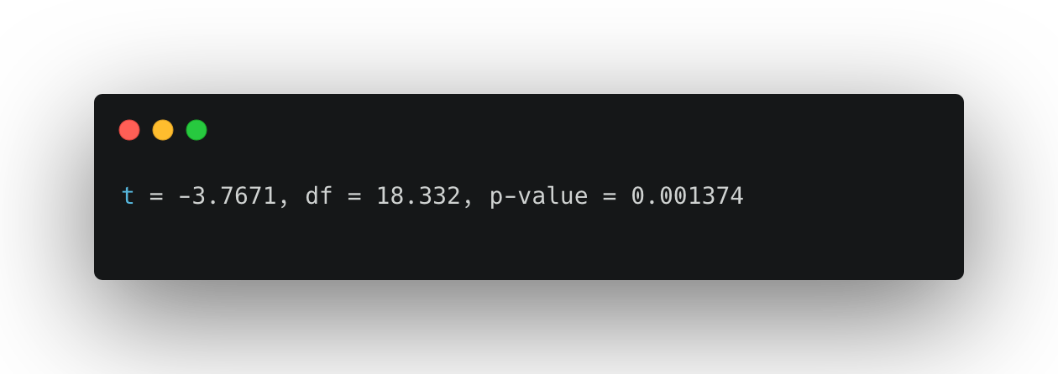
Tables
Plots
Stats
R

Slide 9


Copy -paste
R
Google Doc

Slide 10
R
Google Doc

Slide 11
…
R
Google Doc

Slide 12
Are they synced?
R
Google Doc

Slide 14
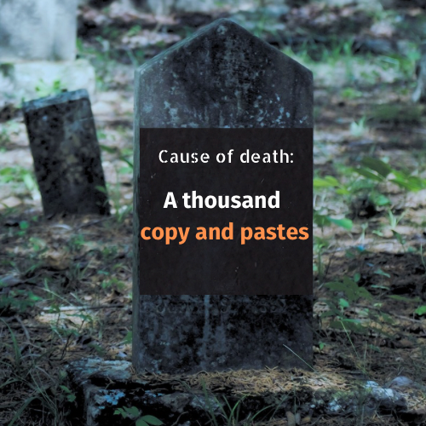
Photo by Kenny Eliason on Unsplash
Edited by Jazelle Maira Carillo

Slide 15
Open Science is about transparency. A self-reproducing manuscript achieves this goal.

Slide 16
Also, it’s cool

Slide 17

I started my GitHub repo
GitHub
github.com/nsunami/dissertation

Slide 18
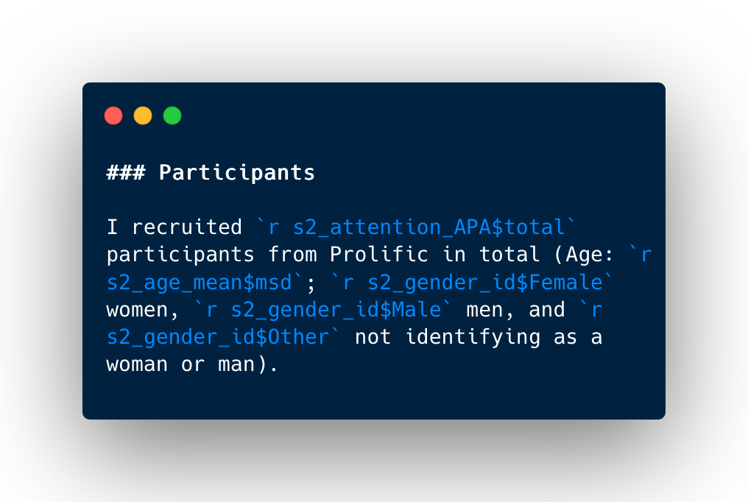
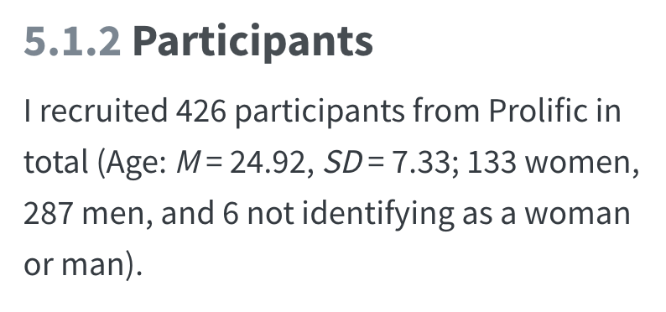
R Markdown to create a document from R
github.com/nsunami/dissertation

Slide 19
When did I start my GitHub repo?
A
B
C
D
Starting my proposal
Proposal defense
PhD Defense

Slide 20
When did I start my GitHub repo?
C
Starting my proposal
Proposal defense
PhD Defense

Slide 21
Regret 1
Not starting early & small
No good git history for the proposal
Less time to develop ”muscles” for the workflow

Slide 22


Where did I store my data?
A
B
C
Managed database
GitHub Repo
Data Repository

Slide 23
My inner Data Steward is not proud!
B
GitHub Repo

Slide 24
Regret 2
Not storing data in a data repository
Bloating the git repo size
Binary file & version control don’t go well
Not FAIR

Slide 25
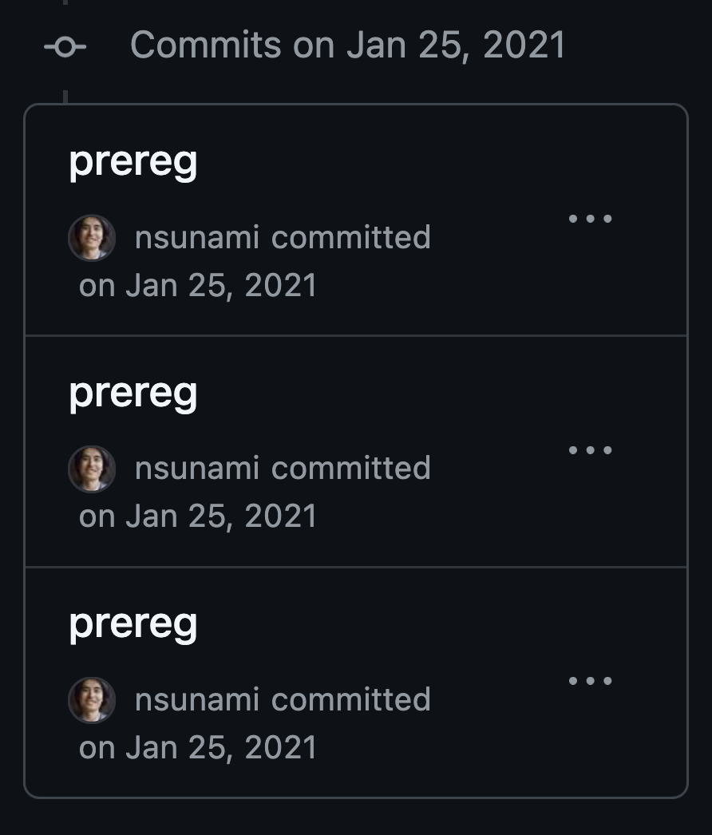
Regret 3
Not committing early, committing often, with meaningful commit messages
Nowadays, I try to follow Conventional Commits
conventionalcommits.org

Slide 26
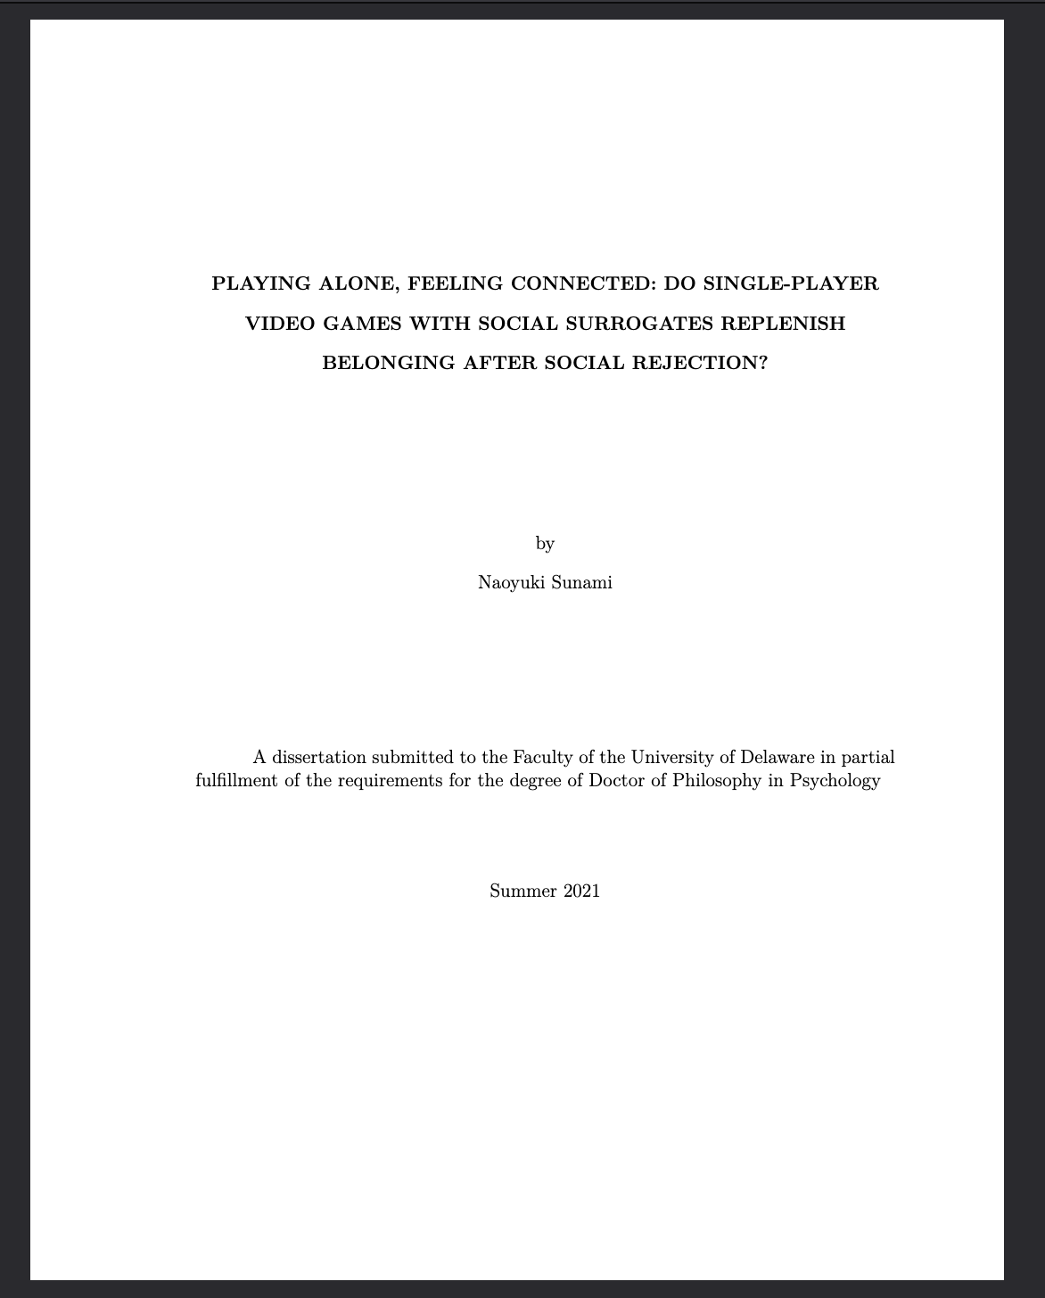
Nevertheless, I was able to render the thesis & graduate

Slide 27
And I thought I was done with my dissertation

Slide 28
Until last year…

Slide 29
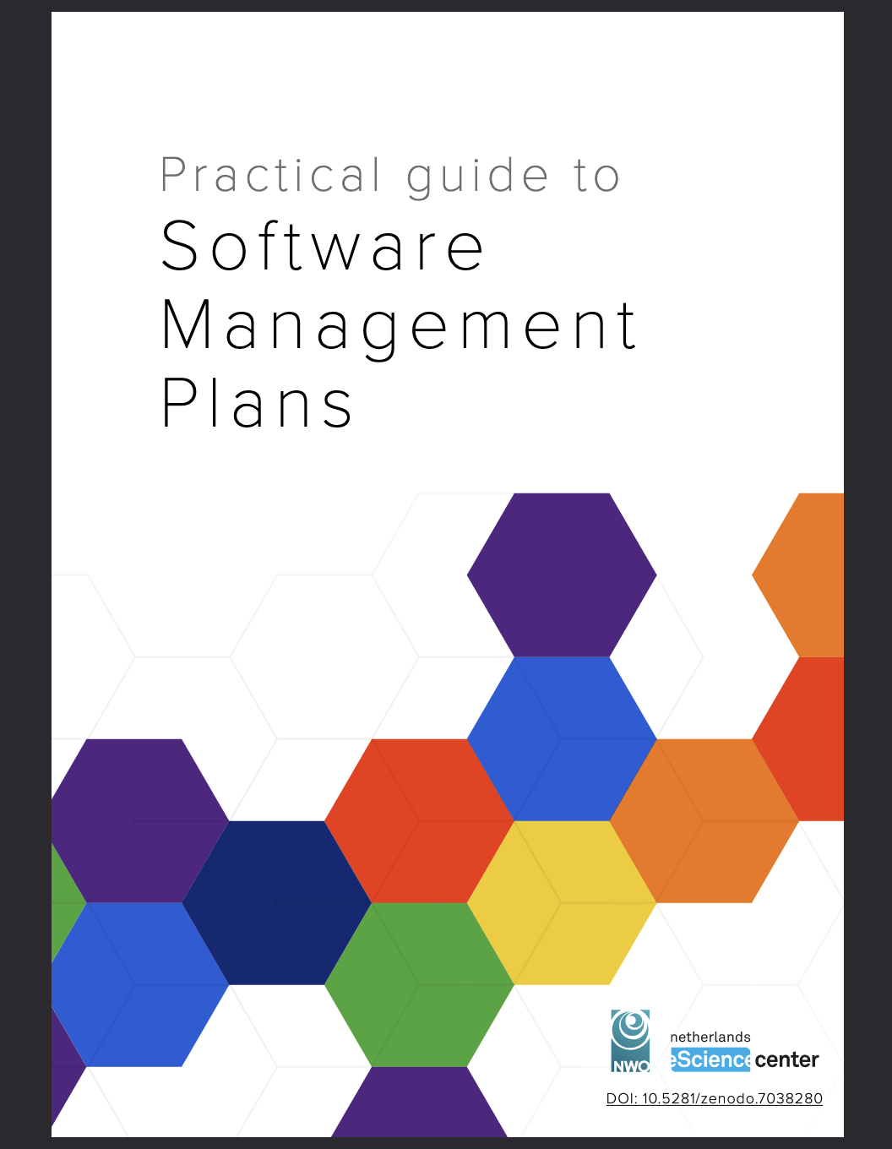
At a meeting about Software Management Plan
I remembered about my dissertation
https://www.esciencecenter.nl/national-guidelines-for-software-management-plans/
https://zenodo.org/records/7248877
Notes:
People were looking for an example of research software, and I said to myself, “I got one”

Slide 30
”It’s been a while. Does my dissertation still run?”
Notes:
I revisited my thesis and it did not work!

Slide 31
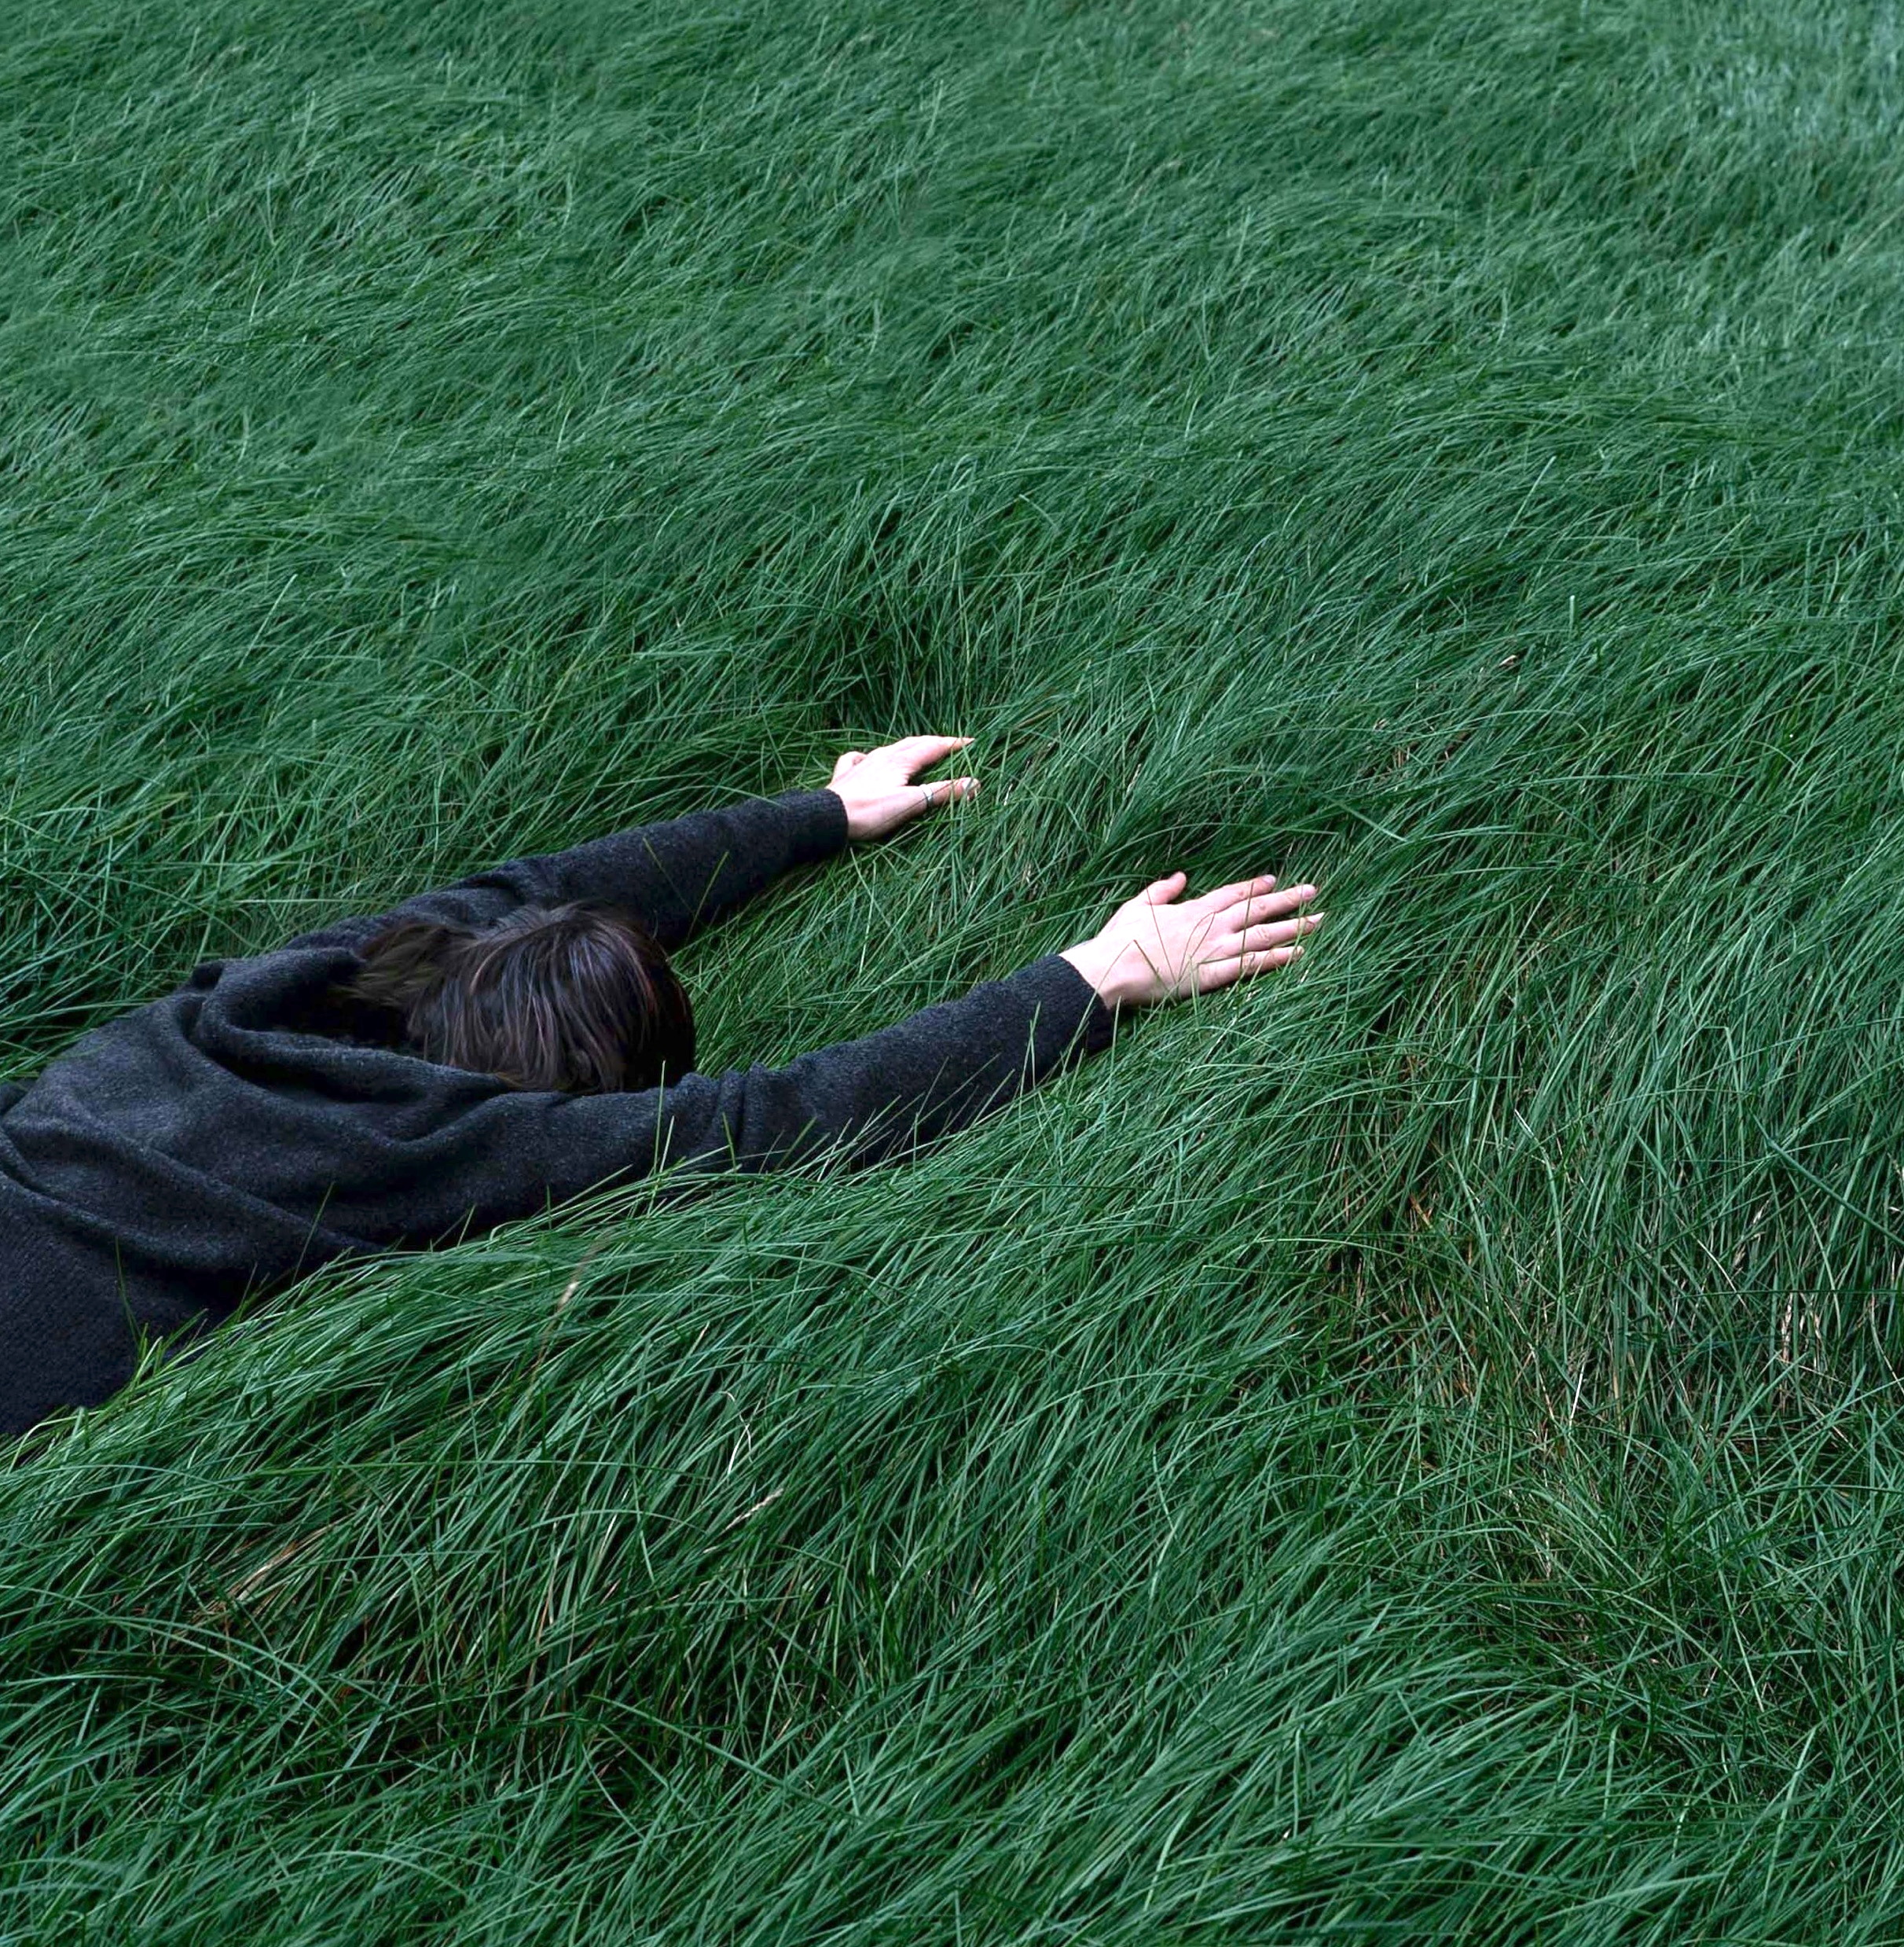
…nope.
Photo by Sonia Dauer on Unsplash
Notes:
I revisited my thesis and it did not work!

Slide 32
What things were broken?
A
B
C
Git-ignoring files that I should not
Could not install dependencies
Issues about LaTeX & PDF rendering

Slide 33
All of these were broken
A
B
C
Git-ignoring files that I should not
Could not install dependencies
Issues about LaTeX & PDF rendering

Slide 34
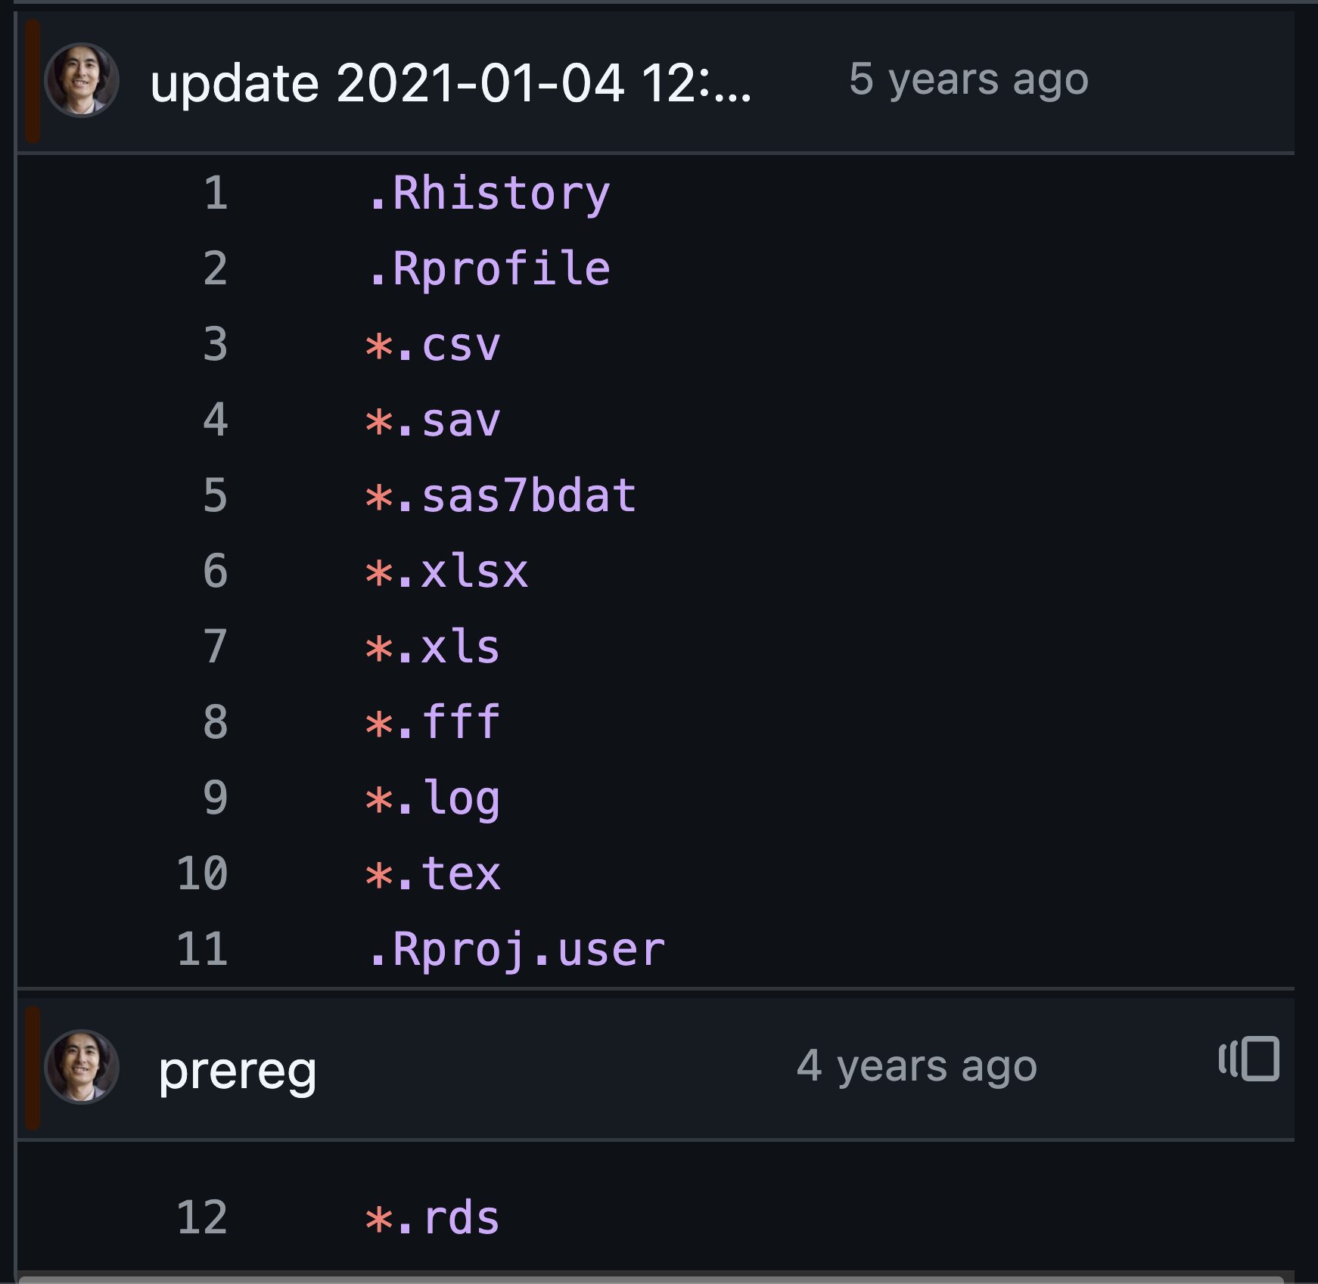
Git-ignoring things that I should not
Regret 4
Treating the git repo as a scratchpad / working directory

Slide 35
Next broken thing: Dependencies

Slide 36
How many packages of dependencies did my dissertation have?
C
101-200
A
Less than 50
B
51-100
D
More than 200

Slide 37
D
More than 200

Slide 38
Total dependencies:
242
packages

Slide 39
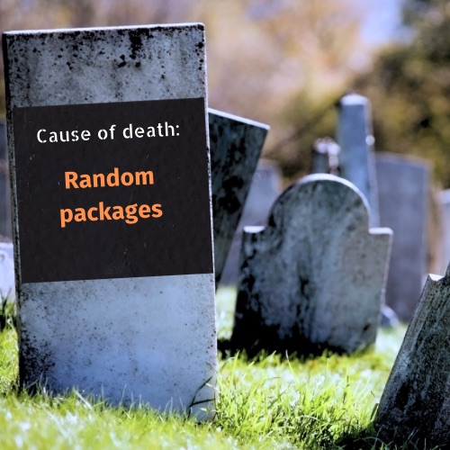
jtyler from Getty Images Signature
Edited by Jazelle Maira Carillo

Slide 40
Regret 4
Not keeping track of dependencies
(& not using a dependency manager)
*Later learning renv would have been a good idea

Slide 41
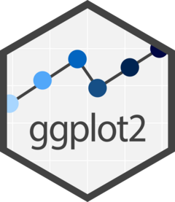
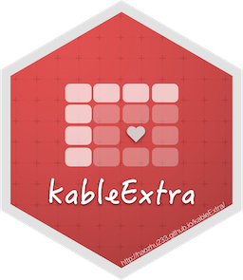

Two types of dependencies
R packages
System Requirements (OS)
lib-png
clang++
libxml2
pak::pkg_deps can help navigating dependencies

Slide 42
Re-installing 242 packages means re-installing their system requirements

Slide 43
Another thing broken: To render a PDF, I also needed LaTeX, another system dependency.

Slide 44
I wanted to snapshot all
lib-png
libxml2
Tiny-Tex
OS environment

Slide 45
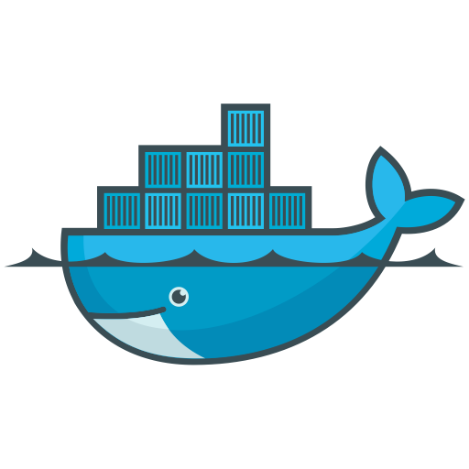
You can create a docker image to do just that
lib-png
libxml2
Tiny-Tex
OS environment

Slide 46
Regret
Not using Docker from the start
(In fact, I finished Dockerizing this weekend.)

Slide 48
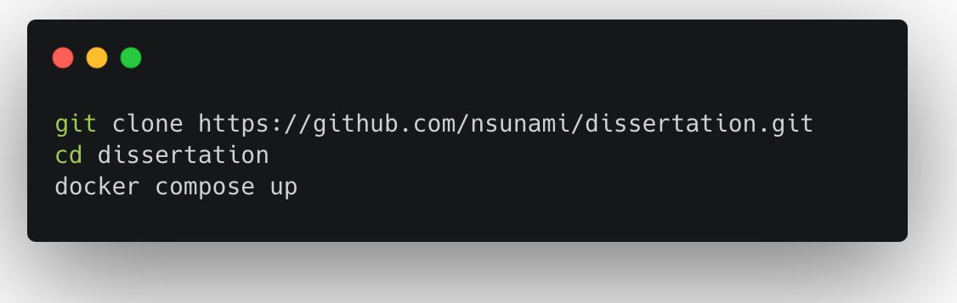
How to reproduce my thesis
And it will be in the docs folder.
https://carbon.now.sh/

Slide 49
Regrets Recap
Not starting early & small
Not using a data repository
Using bad commit practices
Git-ignoring willy-nilly
Letting 240+ dependencies run wild
Not using Docker earlier

Slide 50
Let’s discuss!

Slide 51
Questions
What are your experiences working towards a reproducible paper?
What are your challenges?

Slide 52
Join Our Community
openscience@tue.nl
sites.google.com/view/osceindhoven
Notes:
If you would like to join a community of like-minded people at TU/e – you are welcome to become a member of the OS community Eindhoven.
It’s a space where you can exchange experiences with fellow researchers, learn something new and/or share your knowledge with others.
Starting from the new academic year, we are going to have budget from NWO which will help the community to develop and grow and you can be part of it.

Slide 53
Footnotes
Icon Sources
Lucide.dev
SVGrepo.com
Image Source
Unsplash
This work is marked with CC0 1.0

